Slide 1
Design Project - 4
By: Nittala Satya Surya Lakshmi Vasuki Siva Srinivas
#Id – 620094
Email – sn620094@wne.edu

Slide 2
Butterworth Matching Network Design

Slide 3
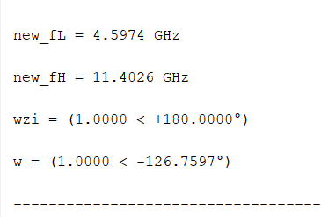
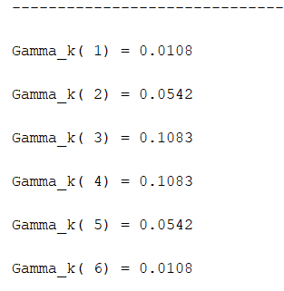
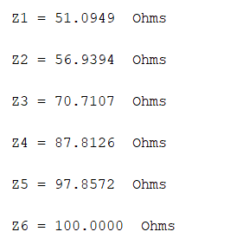
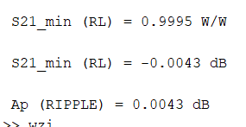
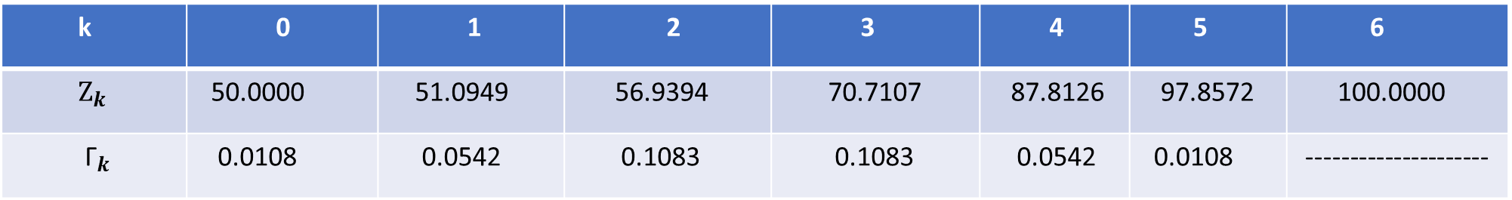
Butterworth Matching Network Design MATLAB Calculations
k | 0 | 1 | 2 | 3 | 4 | 5 | 6
${\text{Z}}_{k}$ | 50.0000 | 51.0949 | 56.9394 | 70.7107 | 87.8126 | 97.8572 | 100.0000
${\text{Γ}}_{k}$ | 0.0108 | 0.0542 | 0.1083 | 0.1083 | 0.0542 | 0.0108 | ---------------------

Slide 4
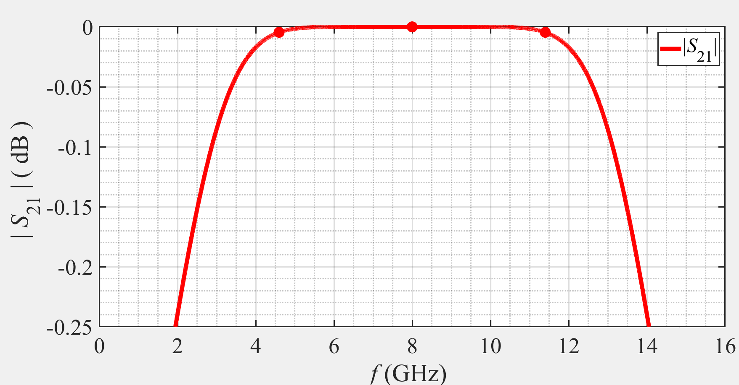

Slide 5
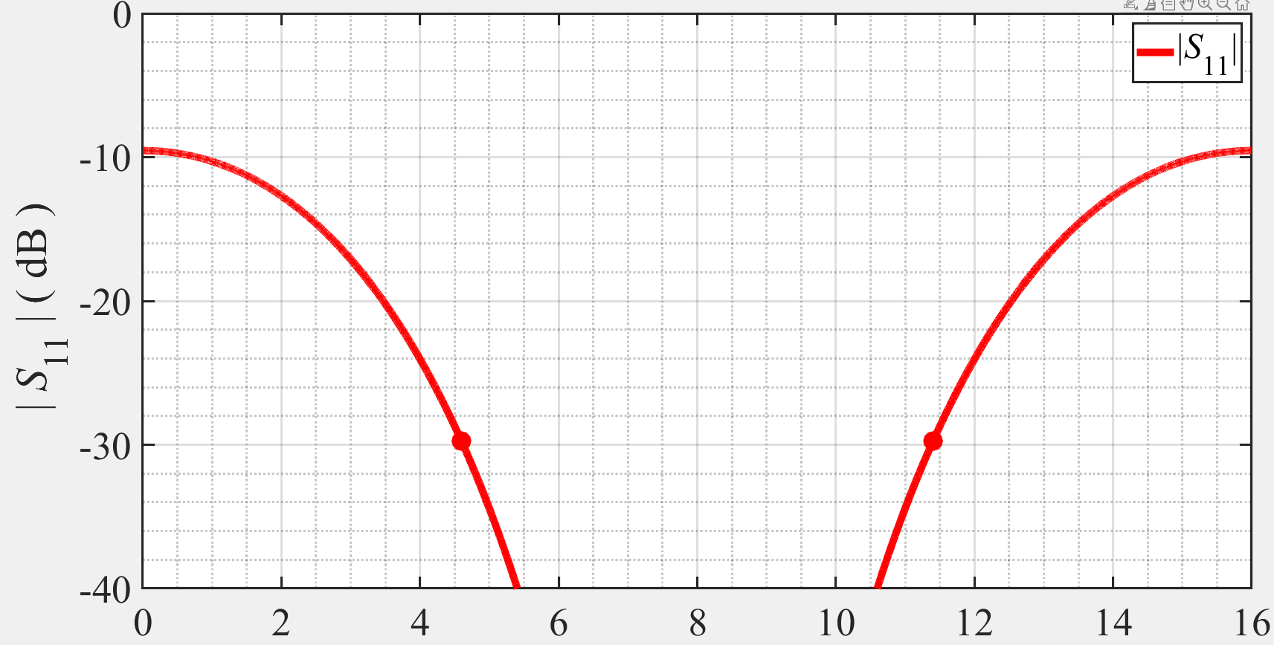

Slide 6
Chebyshev Matching Network Design

Slide 7
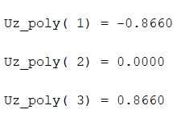
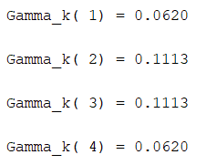
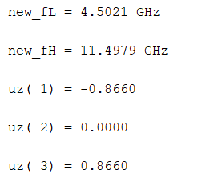
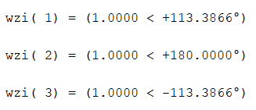
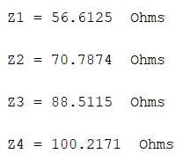
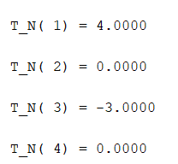
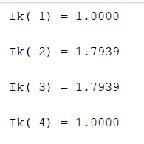
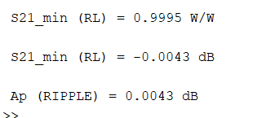
Chebyshev Matching Network Design MATLAB Calculations

Slide 8
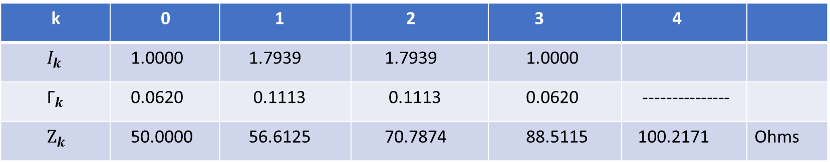
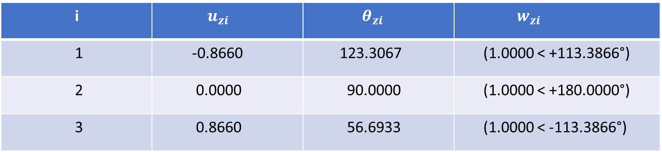
i | $u_{zi}$ | $θ_{zi}$ | $w_{zi}$
1 | -0.8660 | 123.3067 | (1.0000 < +113.3866°)
2 | 0.0000 | 90.0000 | (1.0000 < +180.0000°)
3 | 0.8660 | 56.6933 | (1.0000 < -113.3866°)
k | 0 | 1 | 2 | 3 | 4
$I_{k}$ | 1.0000 | 1.7939 | 1.7939 | 1.0000
${\text{Γ}}_{k}$ | 0.0620 | 0.1113 | 0.1113 | 0.0620 | ---------------
${\text{Z}}_{k}$ | 50.0000 | 56.6125 | 70.7874 | 88.5115 | 100.2171 | Ohms

Slide 9
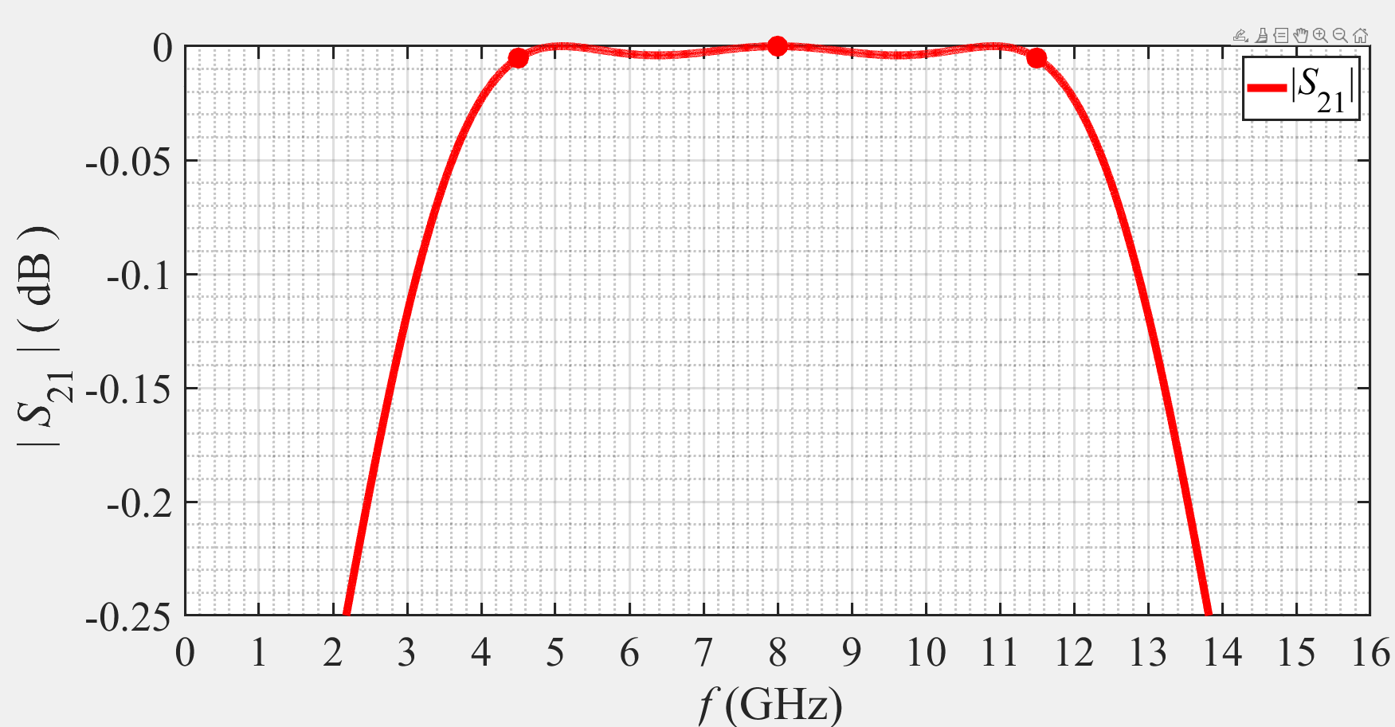

Slide 10
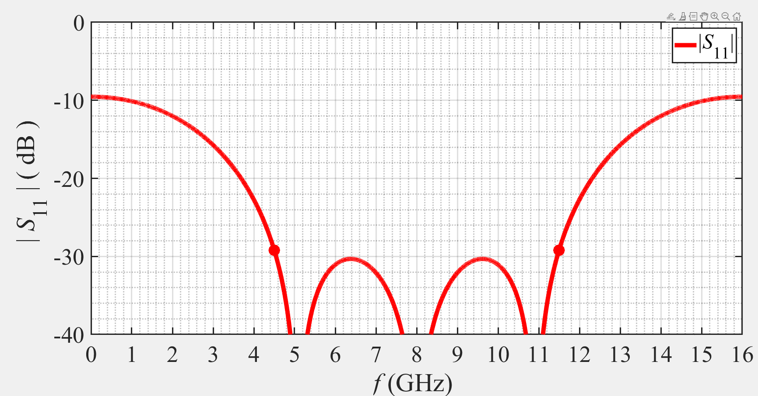

Slide 11
ADS (Microstrip TRLs)

Slide 12
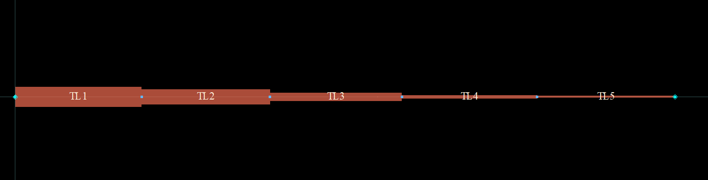
ADS (Microstrip TRLs) Layout

Slide 13
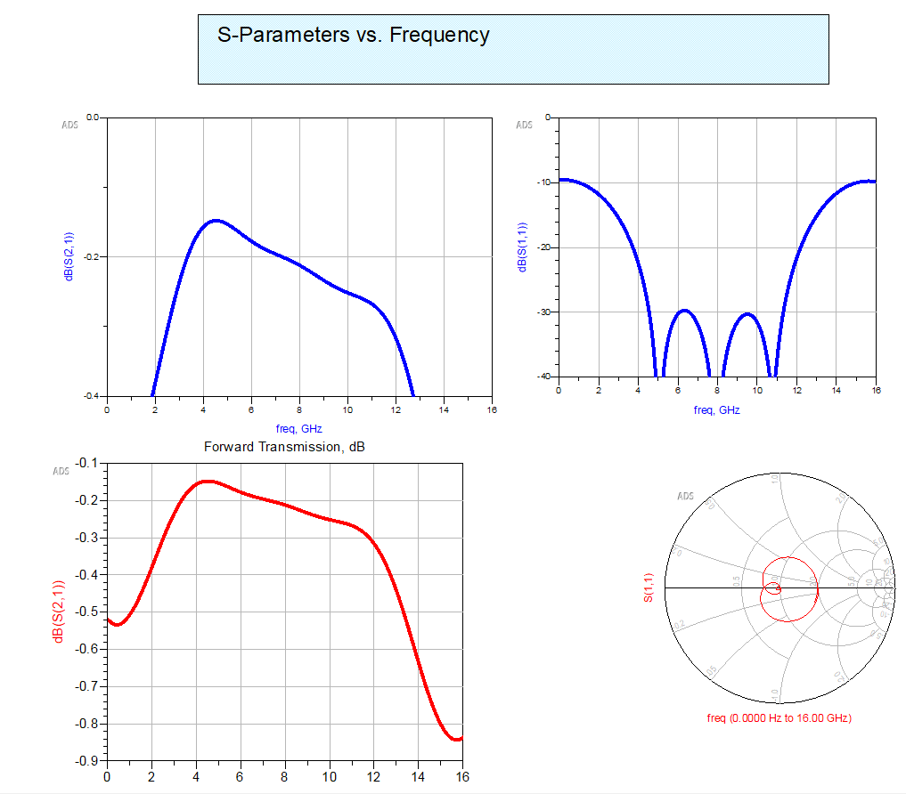
ADS (Microstrip TRLs)

Slide 14
ADS -Microstrip TRLs(MSTEP)

Slide 15
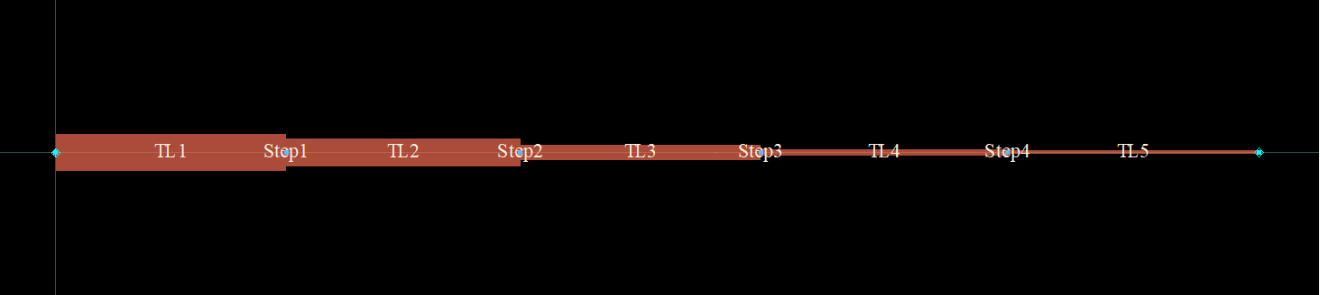
ADS -Microstrip TRLs(MSTEP) Layout

Slide 16
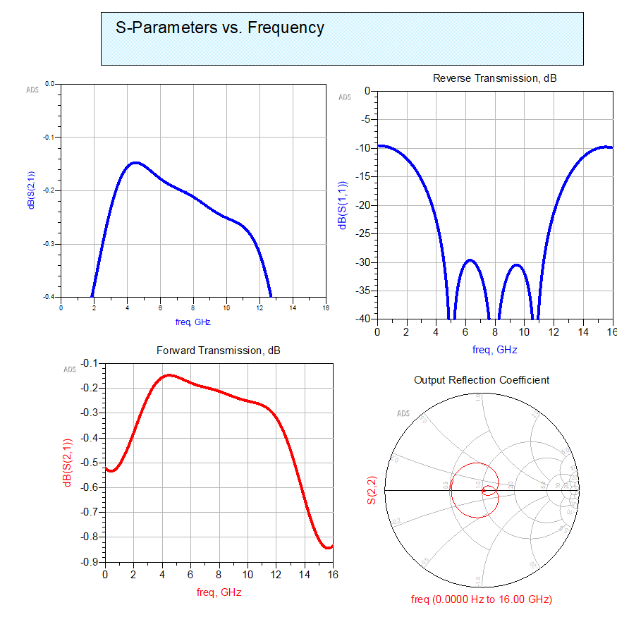
ADS -Microstrip TRLs(MSTEP)

Slide 17
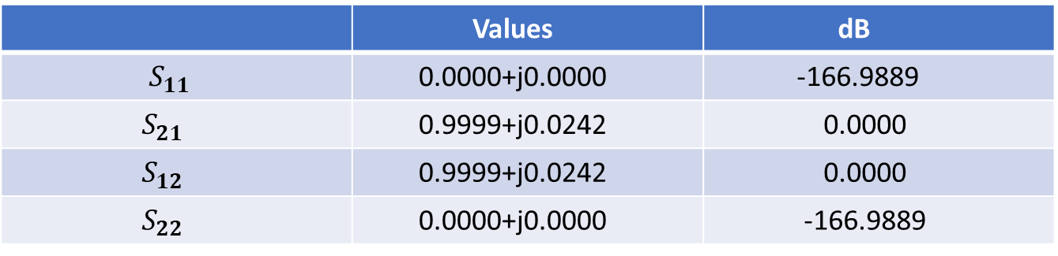
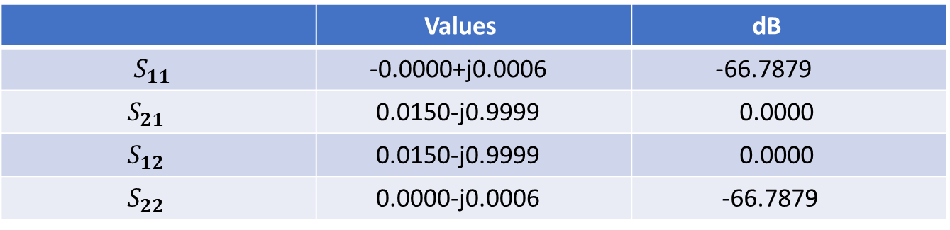
BUTTERWORTH
 | Values | dB
$S_{11}$ | -0.0000+j0.0006 | -66.7879
$S_{21}$ | 0.0150-j0.9999 | 0.0000
$S_{12}$ | 0.0150-j0.9999 | 0.0000
$S_{22}$ | 0.0000-j0.0006 | -66.7879
CHEBYSHEV
 | Values | dB
$S_{11}$ | 0.0000+j0.0000 | -166.9889
$S_{21}$ | 0.9999+j0.0242 | 0.0000
$S_{12}$ | 0.9999+j0.0242 | 0.0000
$S_{22}$ | 0.0000+j0.0000 | -166.9889

Slide 18
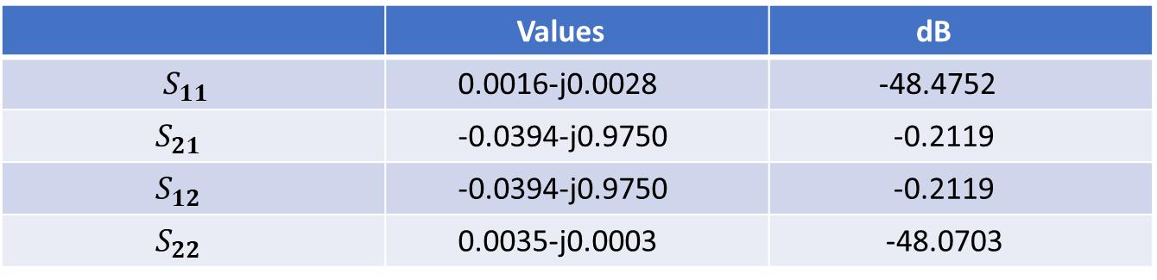
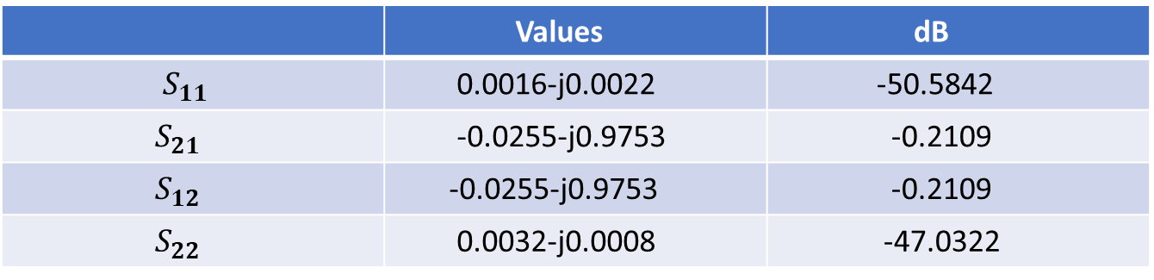
ADS Microstrip
 | Values | dB
$S_{11}$ | 0.0016-j0.0022 | -50.5842
$S_{21}$ | -0.0255-j0.9753 | -0.2109
$S_{12}$ | -0.0255-j0.9753 | -0.2109
$S_{22}$ | 0.0032-j0.0008 | -47.0322
ADS Microstrip Stepped
 | Values | dB
$S_{11}$ | 0.0016-j0.0028 | -48.4752
$S_{21}$ | -0.0394-j0.9750 | -0.2119
$S_{12}$ | -0.0394-j0.9750 | -0.2119
$S_{22}$ | 0.0035-j0.0003 | -48.0703

Slide 19

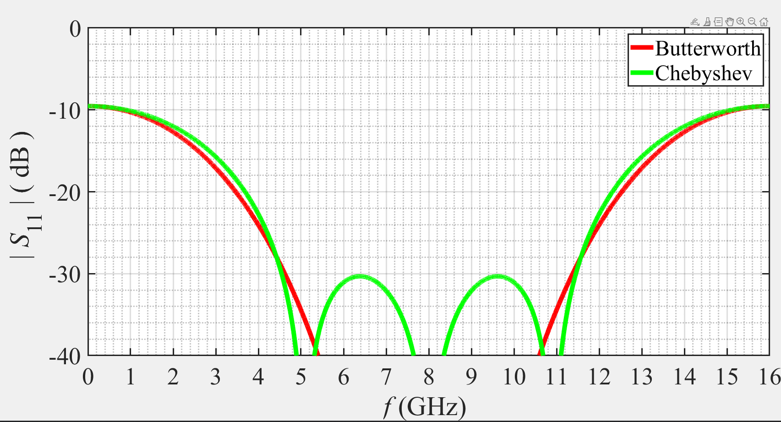

Slide 20

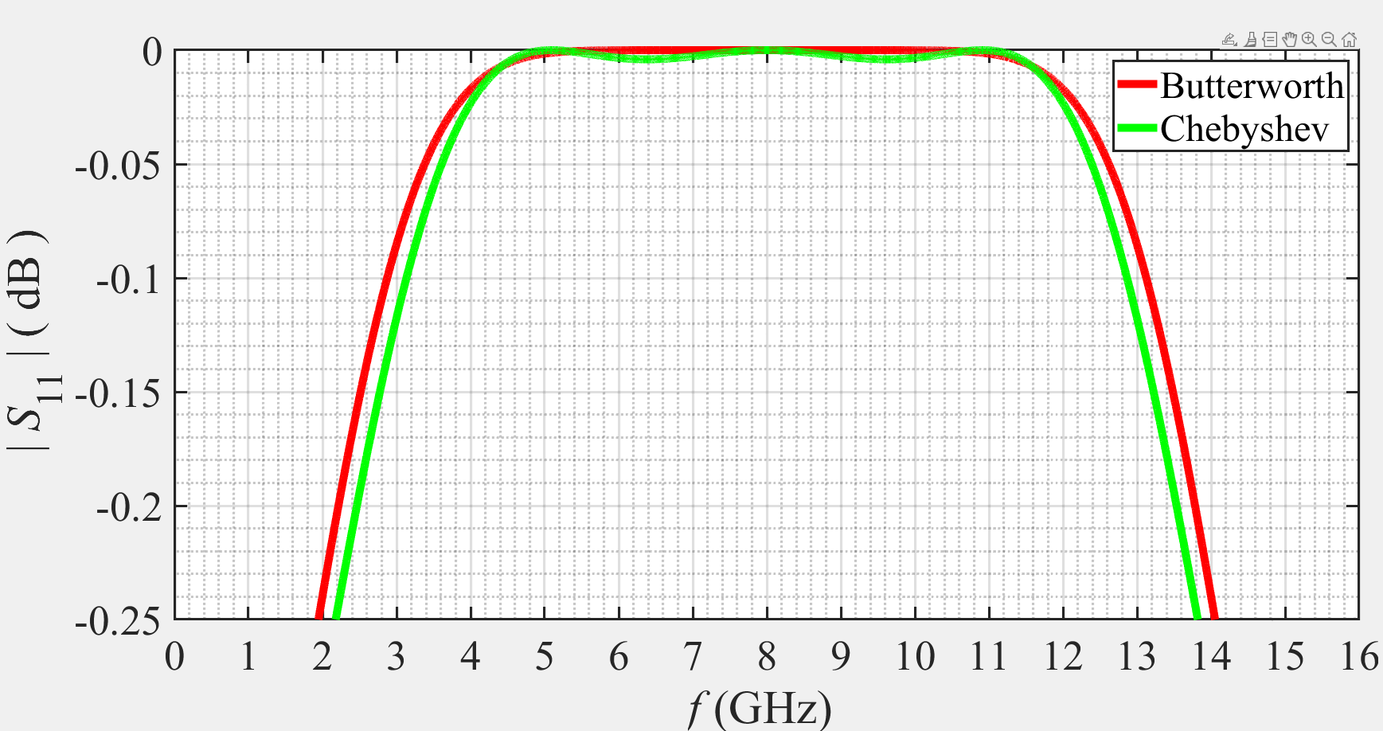

Slide 21

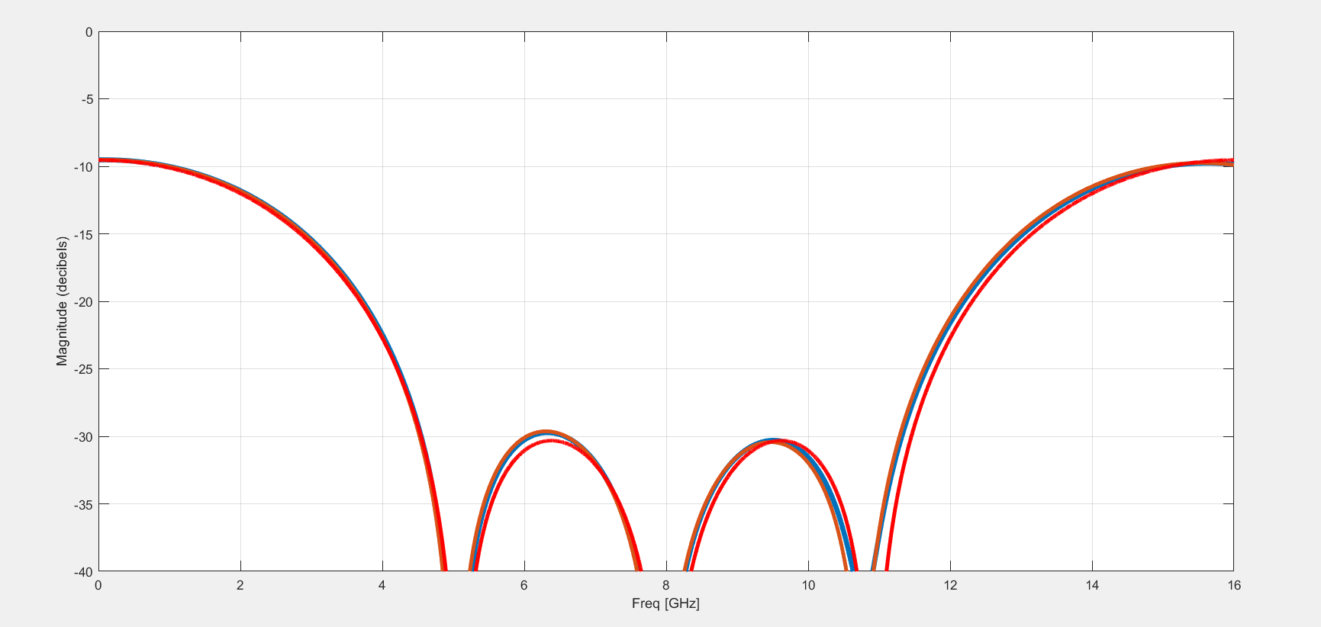
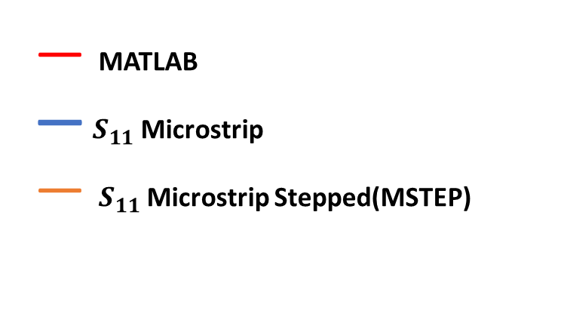
— MATLAB
— $S_{11}$ Microstrip
— $S_{11}$ Microstrip Stepped(MSTEP)

Slide 22

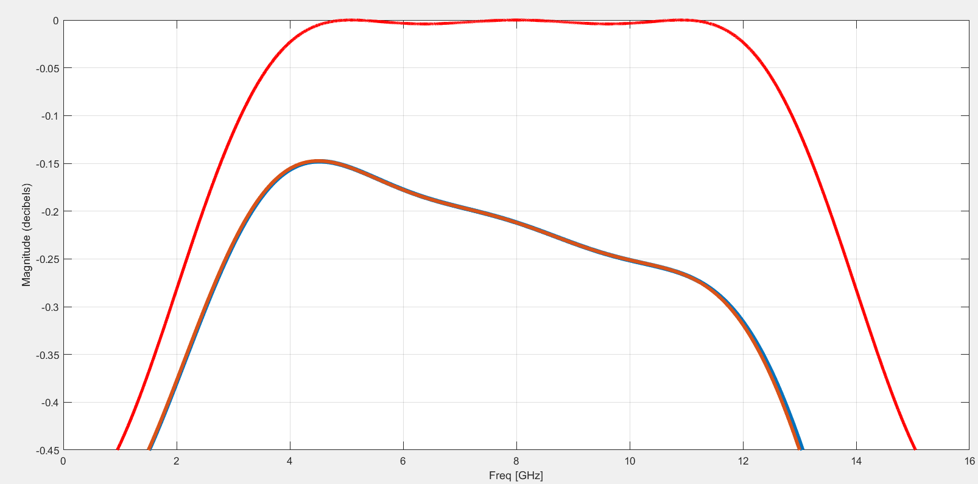

— MATLAB
— $S_{21}$ Microstrip
— $S_{21}$ Microstrip Stepped(MSTEP)

Slide 23
The End

